Slide 1

Introduction and Advanced workshop
Casper R. Tak

Slide 2
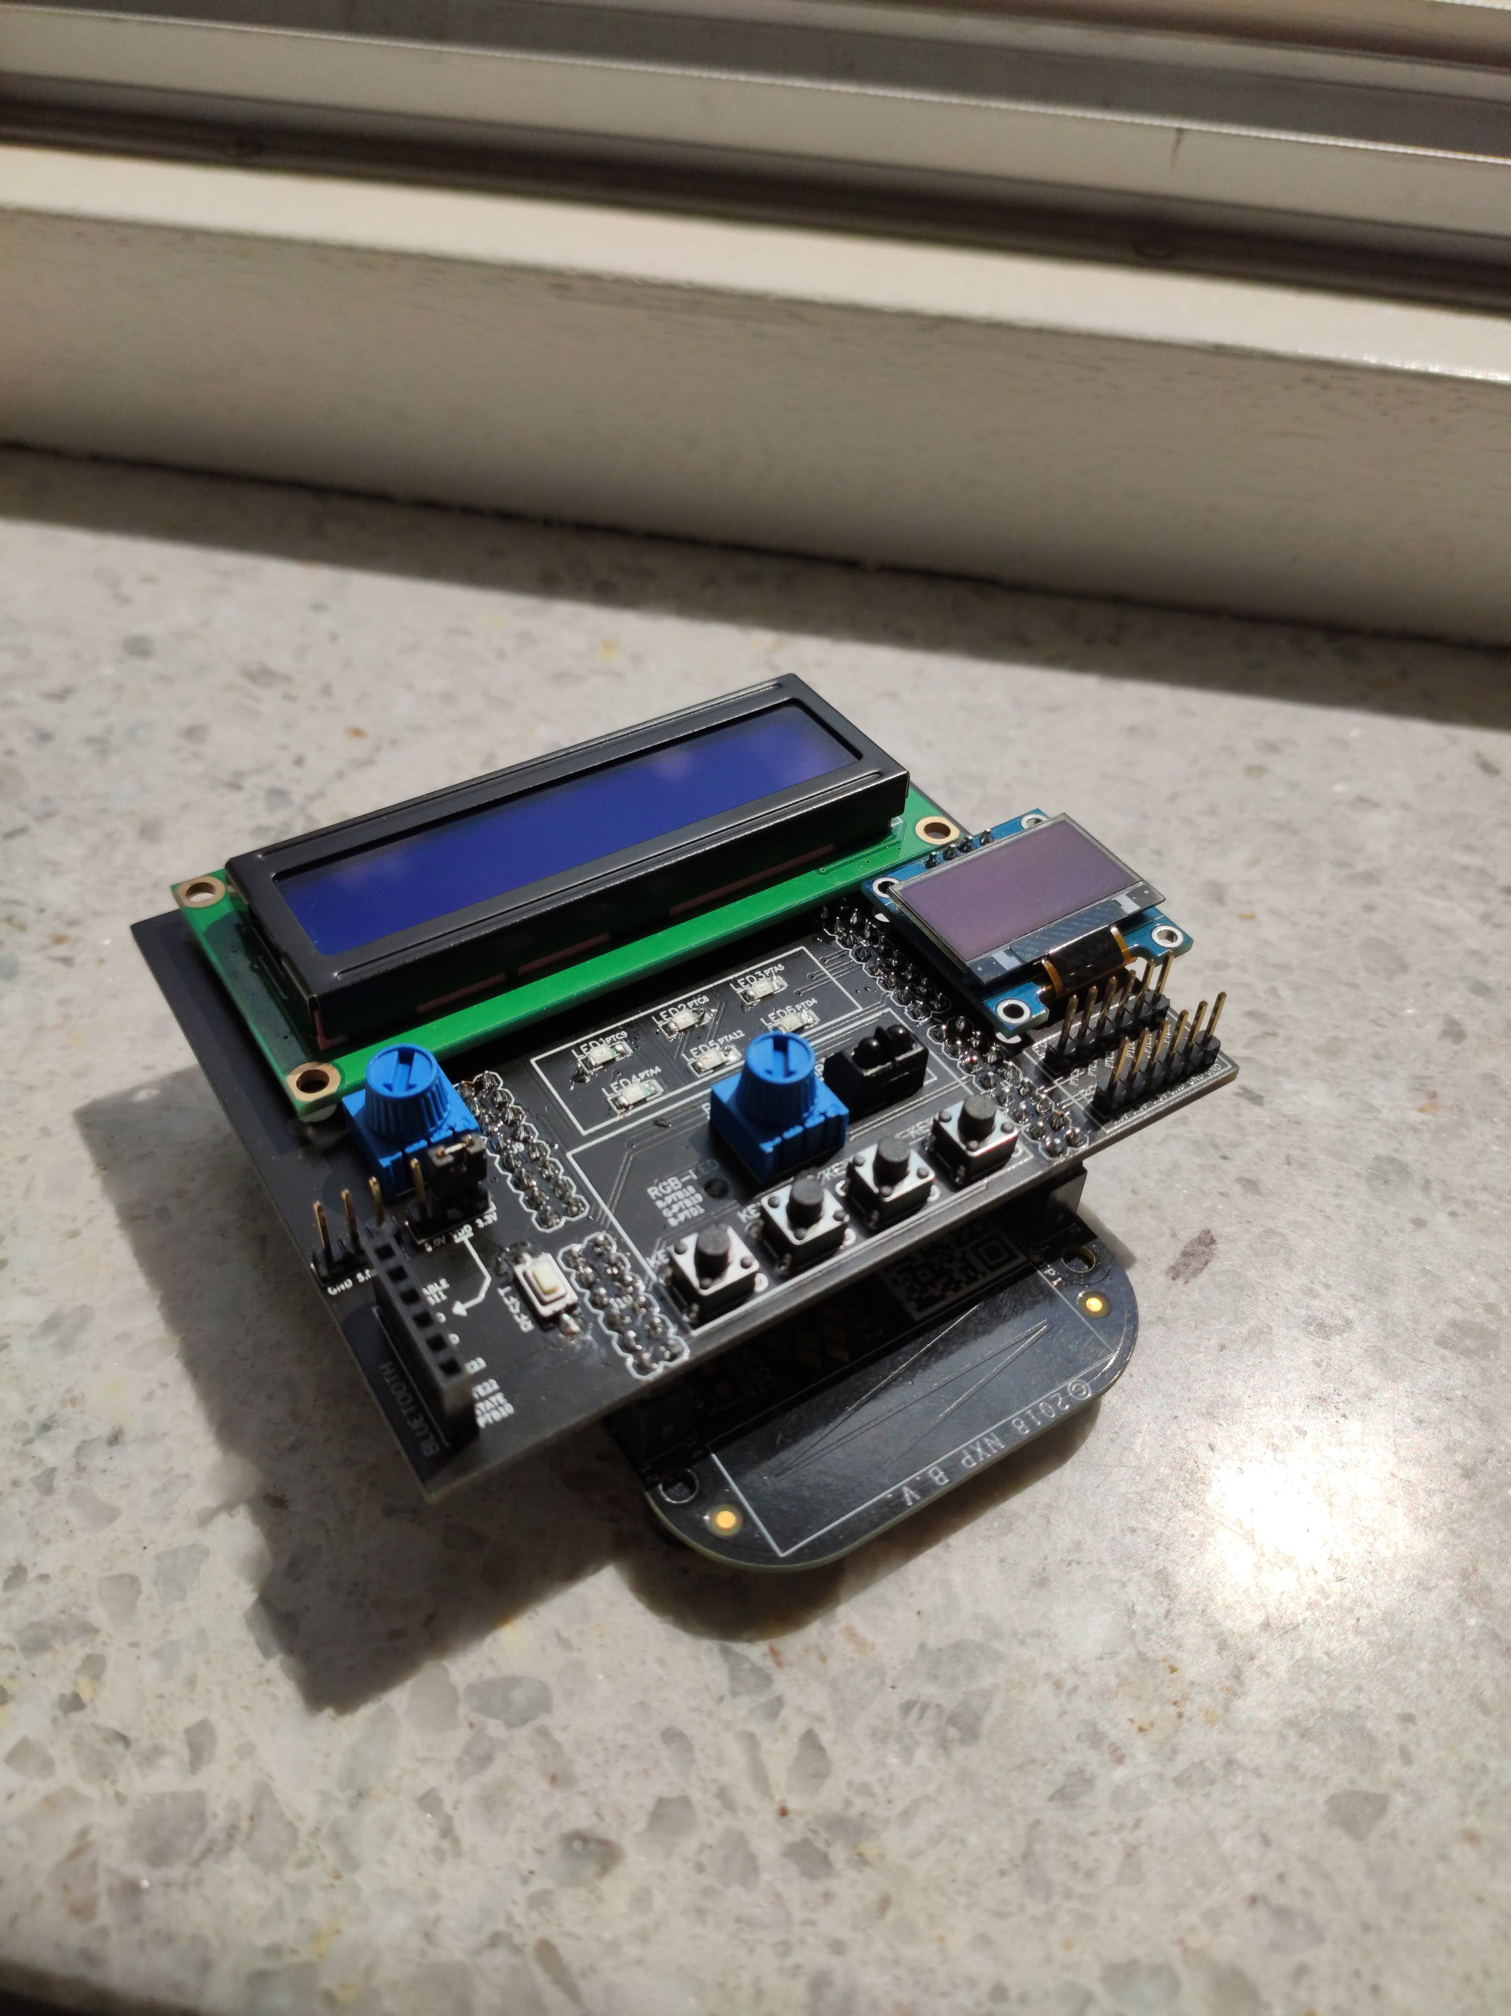
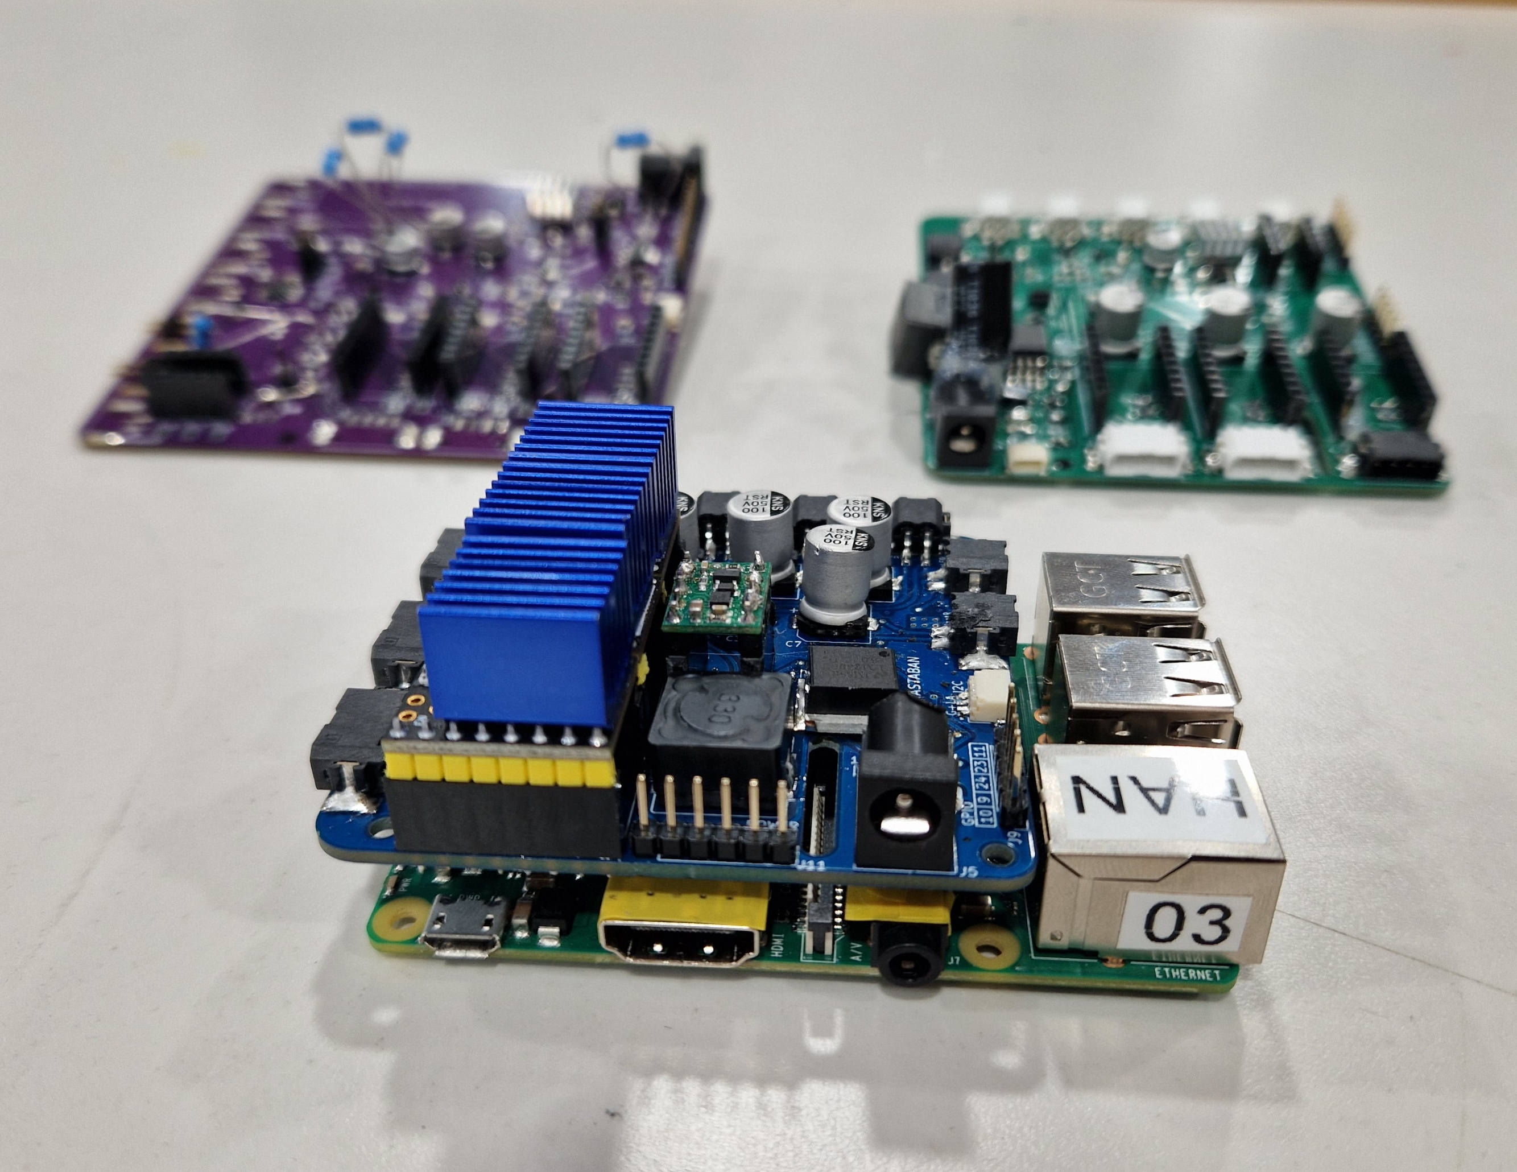
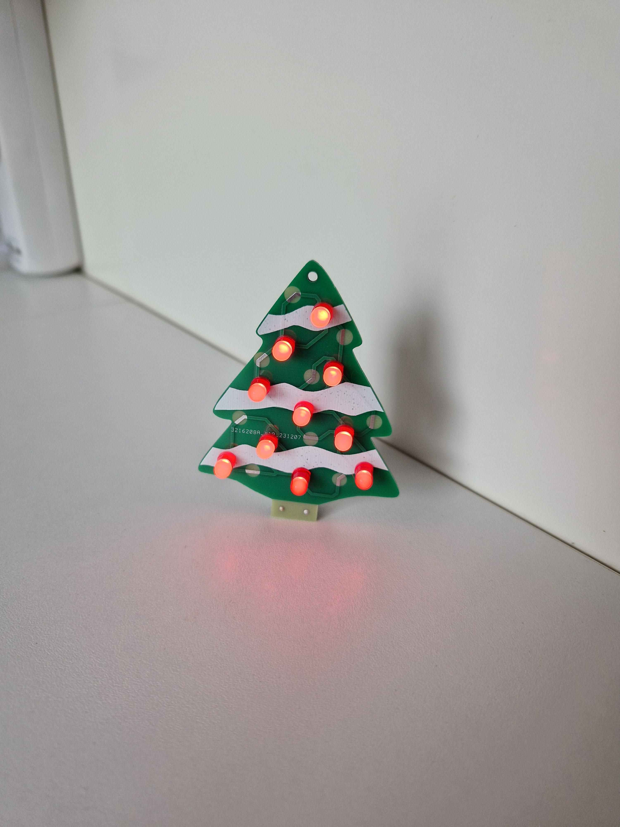
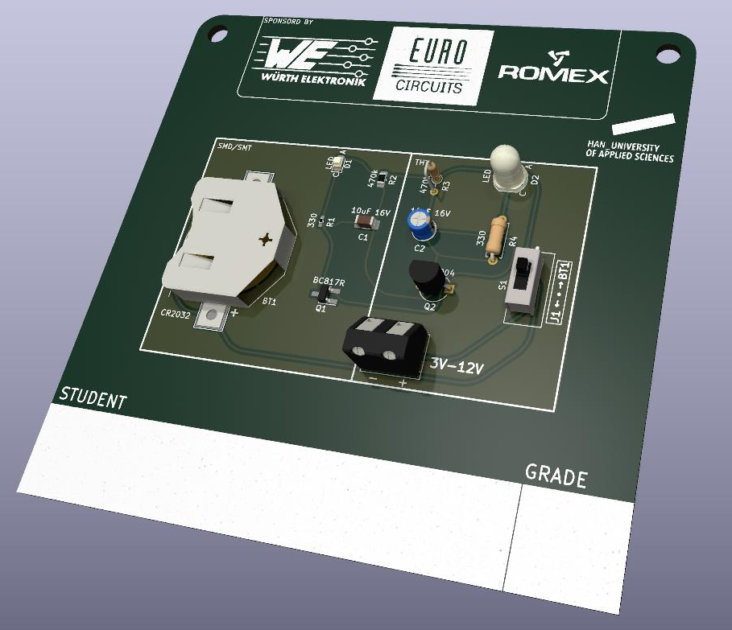
KiCad workshop introduction
Whoami?
Why go through the trouble of:
Designing the PCB
Waiting for it to arrive
Figuring out and finding the (many) mistakes
And then doing it all over again, while the deadline is approaching…
Timing: when to start designing a PCB?
Breadboard first (if possible)
Why not Altium/Eagle/etc.?
Open source (FREE!*)
Regularly updated and added features
Plugins
Cross-Platform Compatibility
Export options
Notes:
*100% free but maybe consider a donation, to keep it that way.

Slide 3
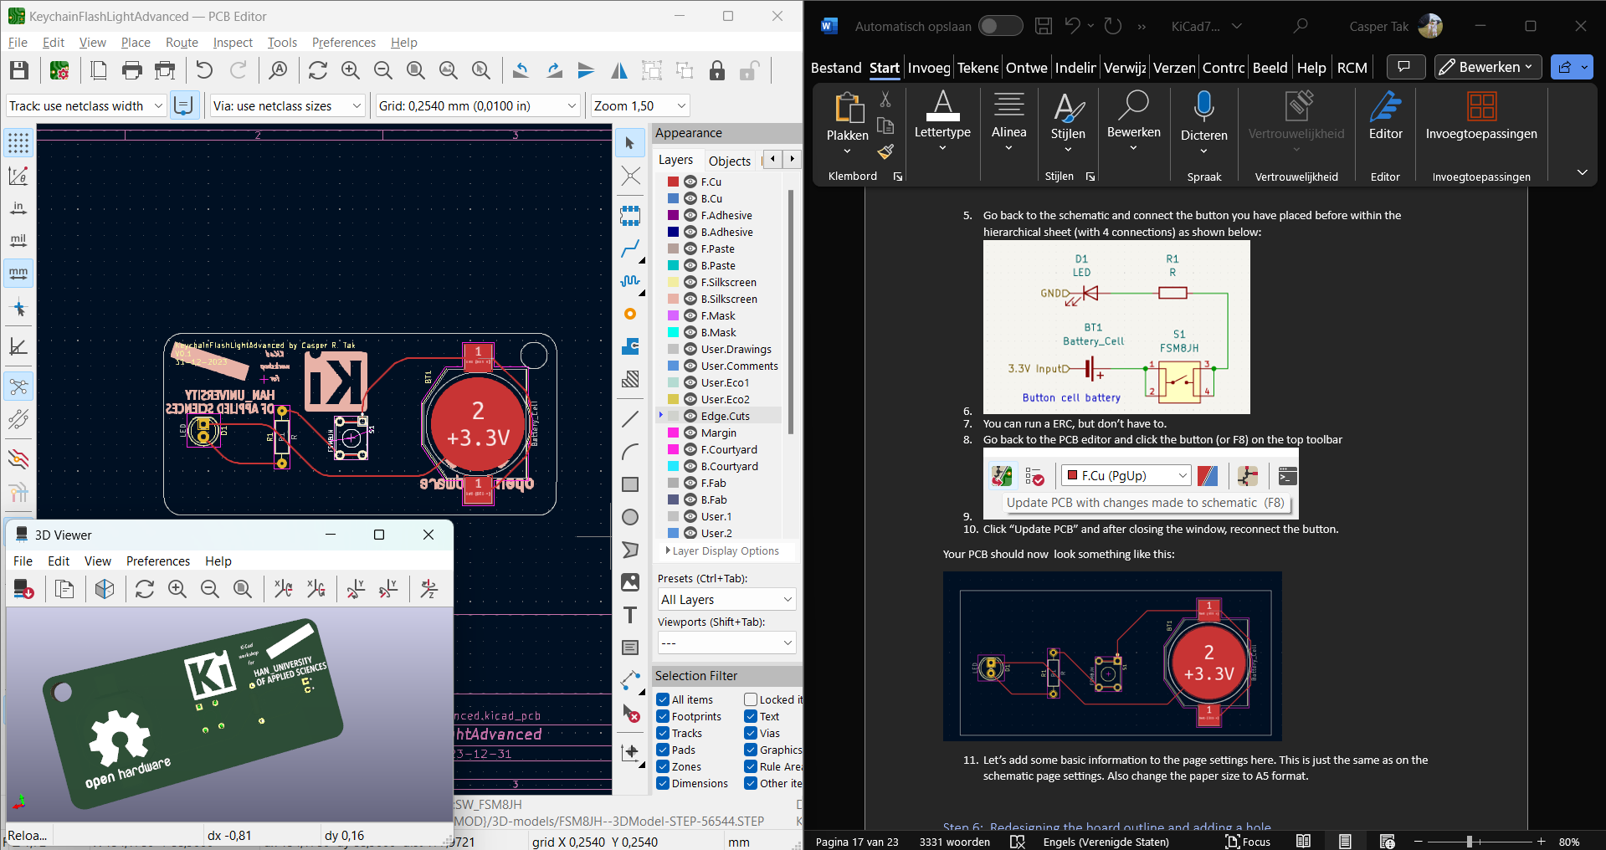
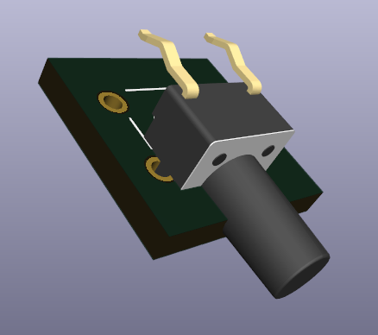
The Workshops
2 workshops:
Introduction Workshop
Unlock the essentials of KiCad in our introductory workshop, covering everything from downloading and installing the software on your Windows computer to mastering project setup, component addition, wiring, footprint assignment, error checking, PCB design, board outline creation, routing connections, and concluding with a thorough 3D review for project alignment.
Advanced Workshop
Elevate your KiCad proficiency in our advanced workshop, exploring personalized schematic touches, text annotations, advanced schematic organization, netlabels, library management, aesthetic PCB customization, and incorporating advanced features such as rounded PCB corners, silkscreen additions, symbolic enhancements, and extra boosts like library integration and KiCad add-ons for a more polished and professional design.

Slide 4
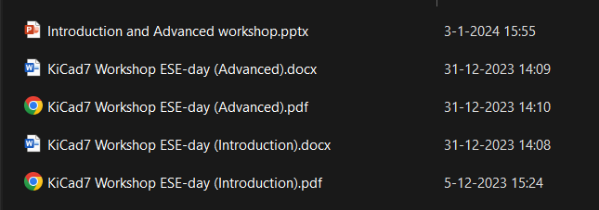
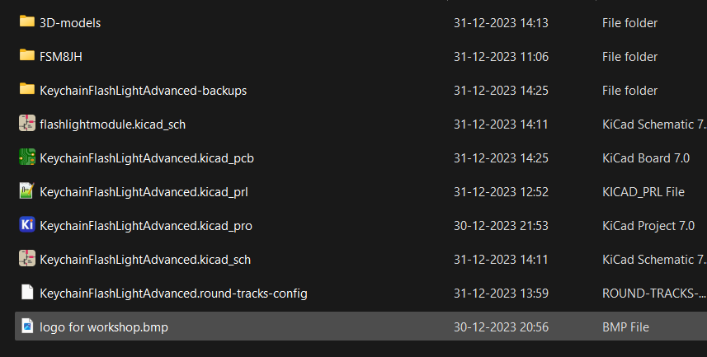
Requirements
Mandatory:
A laptop (Preferably with Windows)
KiCad V7.0.7 installation file (from official KiCad website)
The workshop files (from GitHub)
Documents
Project files
Recommended:
A computer mouse
An internet connection

Slide 5
Good luck and have fun!
Need any help or have questions in general: ASK! We are here to help each other learn new things because we like electronics!
Finished? Please try and surprise us with your own additions, make it YOUR design! (Maybe download a funny .bmp for on your PCB?)
Feedback? Yes please, we want to make this a fun experience for ALL!

